Slide 1

WEB APP FOR CYBERBULLY DETECTION
INT 200
Team Members : -
Pathipati Shashank (E0121026)
Magesh Boopathi S (E0121040)
Shreeshaa S (E0221026)
Project Guide : - Dr. Jayanthi Ganapathy Prof.Ramya M

Slide 2
INTRODUCTION
Definitions
Cyber
Bullying
29/07/2022
INT 200

Slide 3

Cyber
/ˈsʌɪbə/
Prefix
relating to electronic communication networks and virtual reality.
https://www.oxfordlearnersdictionaries.com
/definition/english/cyber#:~:text=cyber%2Dombining%20form,communication%20networks%2C%20especially%20the%20internet
29/07/2022
INT 200

Slide 4


Bully
/ˈbʊli/
Verb
Seek to harm, intimate or coerce (someone perceived as vulnerable).
https://www.oxfordlearnersdictionaries.com/definition/english/bully_1#:~:
text=%2F%CB%88b%CA%8Ali%2F-,%2F%CB%88b%CA%8Ali%2F,frighten%20or%20hurt%20weaker%20people
29/07/2022
INT 200

Slide 5
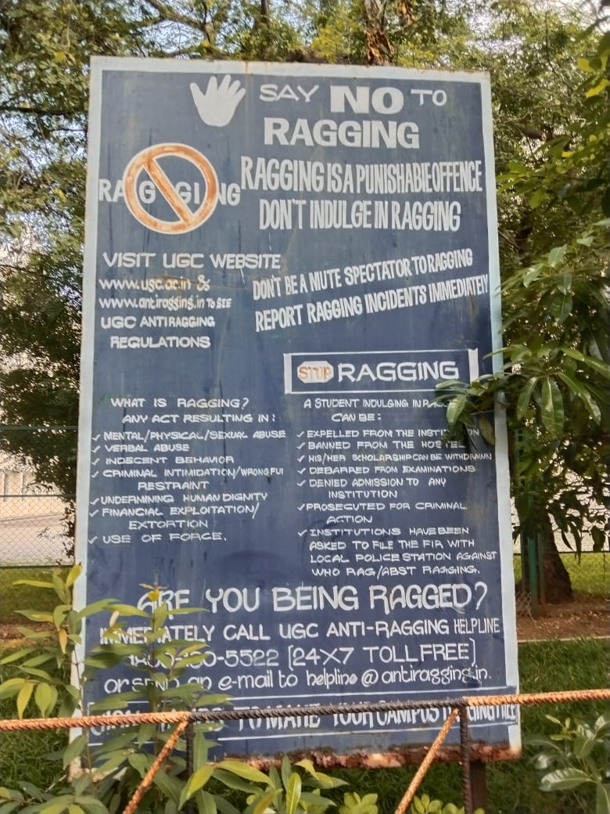
Anti – Bullying Poster in SRET Campus
29/07/2022
INT 200

Slide 6
Cyber Bullying
/ˈsʌɪbəˌbʊlɪɪŋ/
Noun
the use of electronic communication to bully a person, typically by sending messages of an intimidating or threatening nature.
https://www.oxfordlearnersdictionaries.com/definition/english/cyberbully#:~:
text=%2F%CB%88sa%C9%AAb%C9%99rb%CA%8Ali%2F,to%20frighten%20or%20upset%20somebody
29/07/2022
INT 200

Slide 7
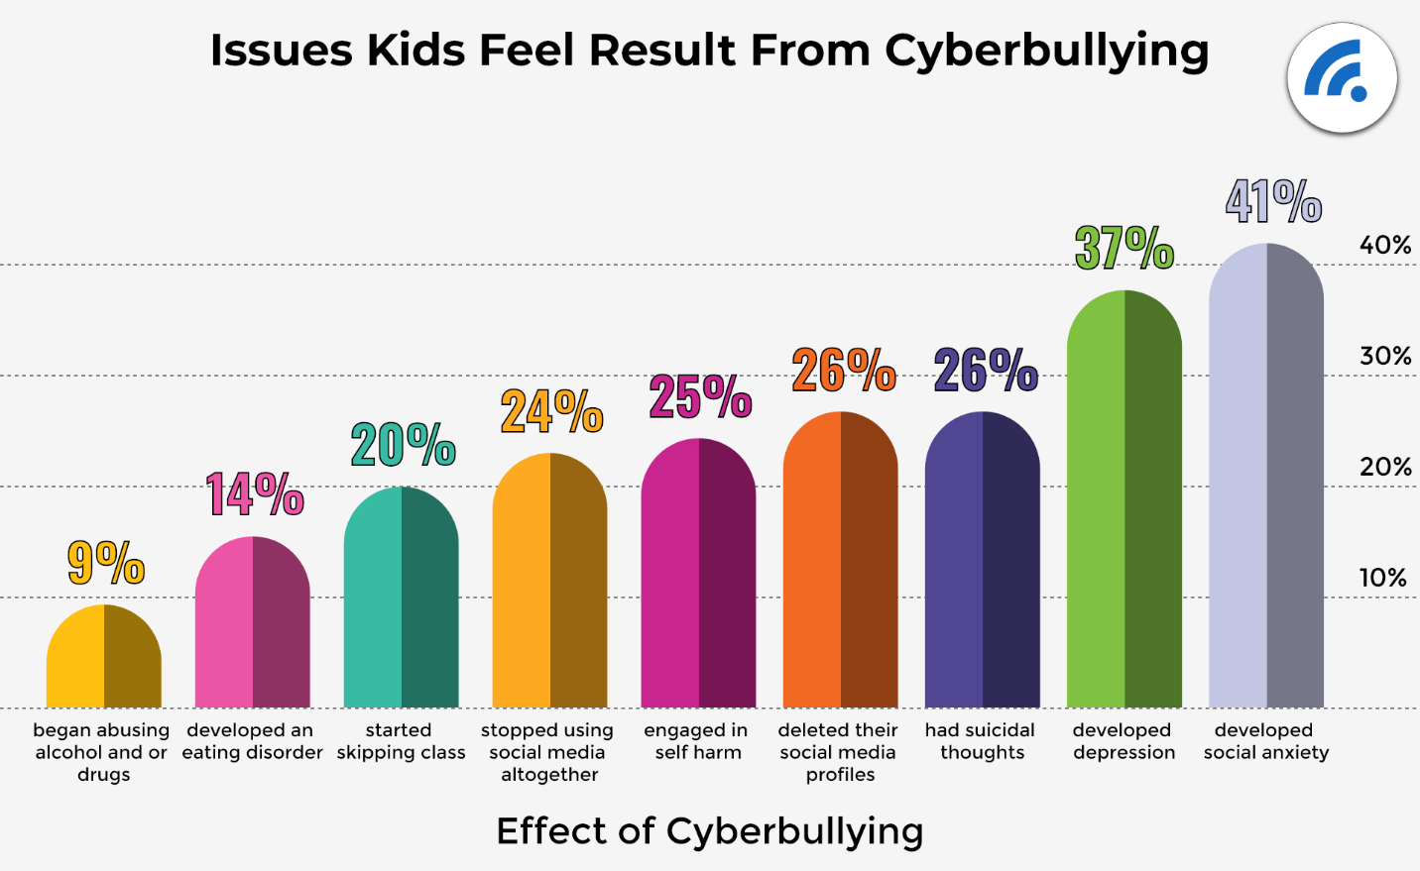
https://www.broadbandsearch.net/blog/cyber-bullying-statistics/amp
29/07/2022
INT 200

Slide 8
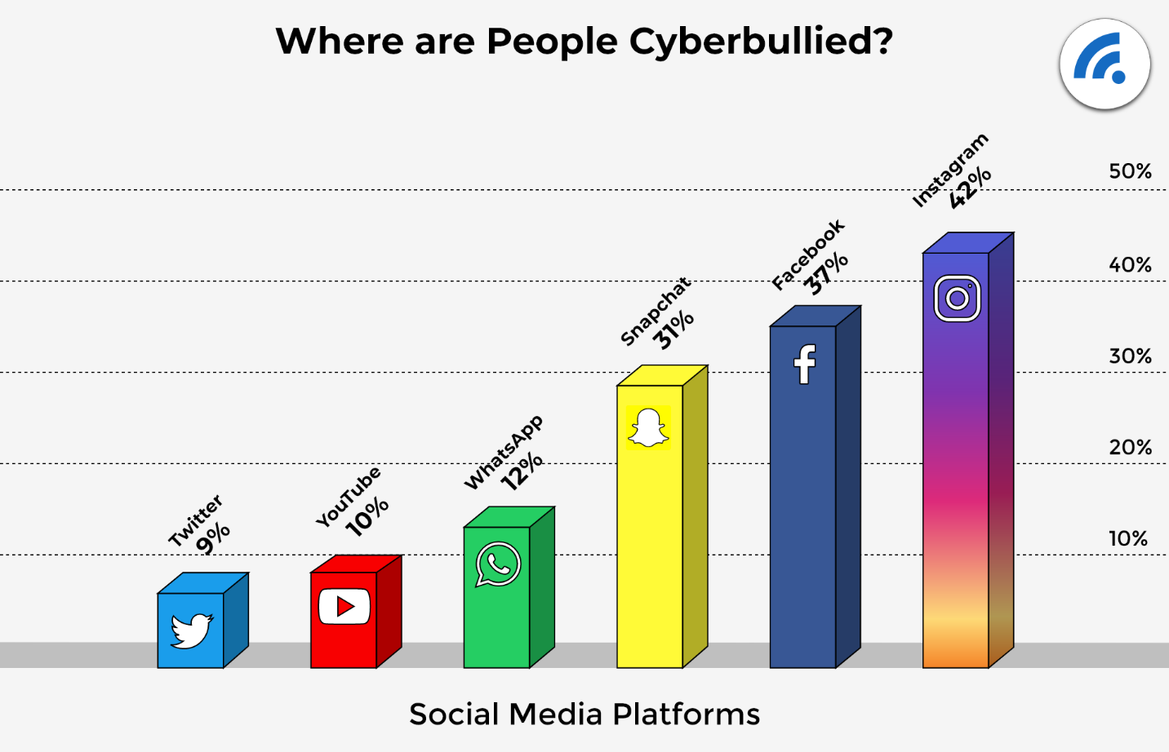
https://www.broadbandsearch.net/blog/cyber-bullying-statistics/amp
29/07/2022
INT 200

Slide 9
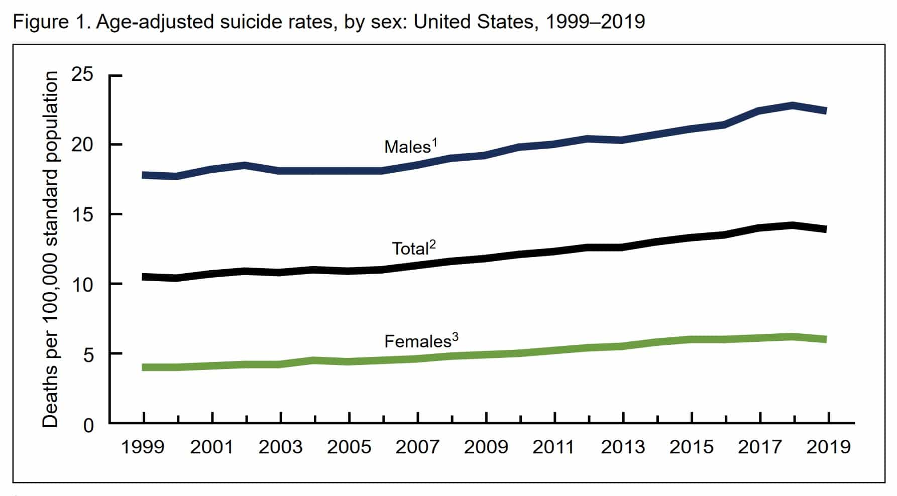
https://www.broadbandsearch.net/blog/cyber-bullying-statistics/amp
29/07/2022
INT 200

Slide 10
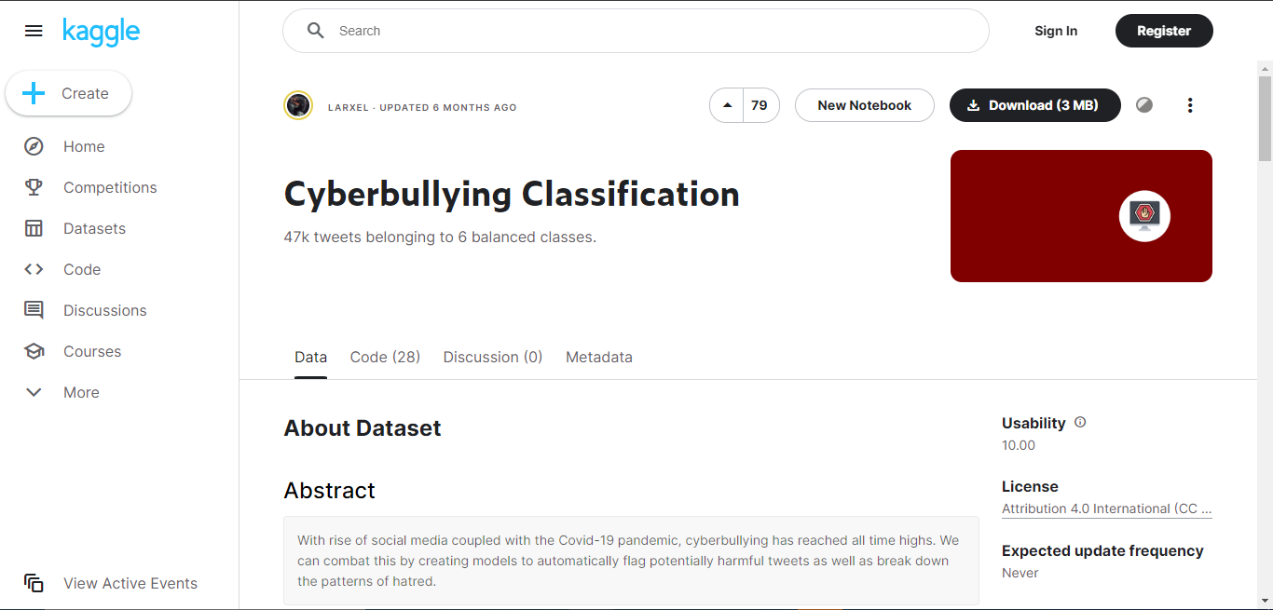
Dataset for Cyber Bully Analysis
https://www.kaggle.com/andrewmvd/cyberbullying-classification
29/07/2022
INT 200

Slide 11
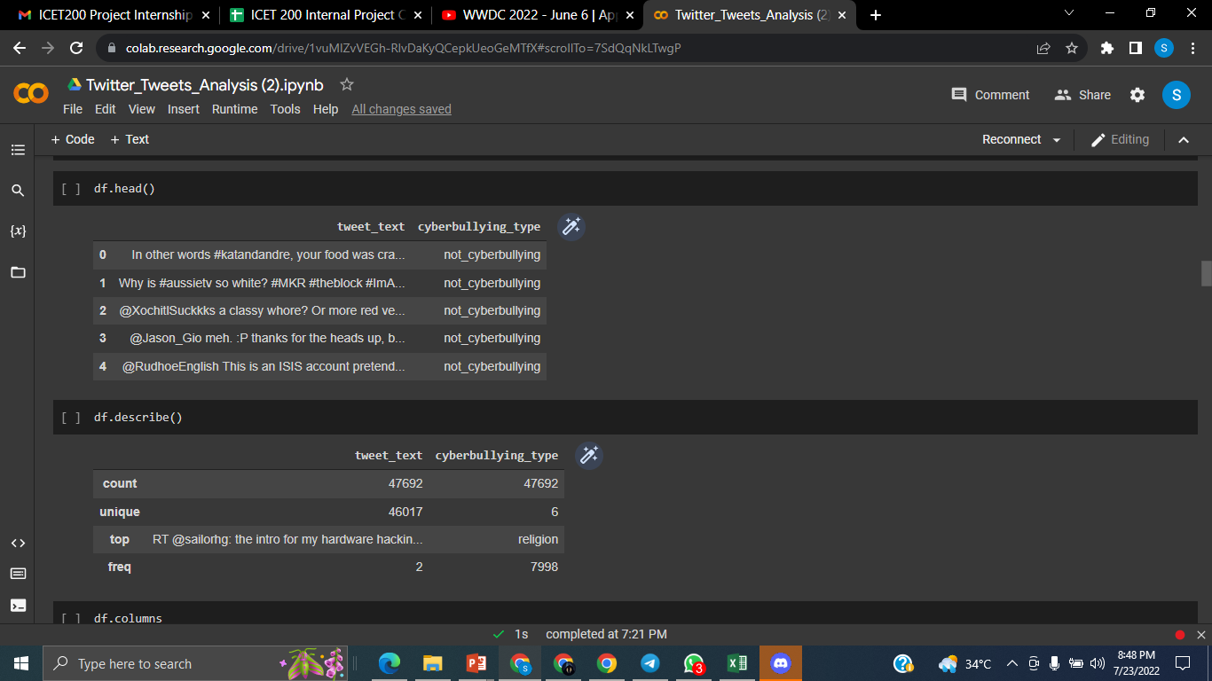
Data Analysis
29/07/2022
INT 200

Slide 12
Data Cleaning
Function | Functionality
get_emoji_regexp(): | Returns compiled regular expression that matches all emojis
remove_emoji(text) | To remove the given emoji
clean_text(text) | Returns the given string without links, punctuations, non ascii characters and stopwords
decontract(text) | To expand contractions from the input string
clean_hashtags(text) | To remove twitter hashtags from input strings
filter_chars(a) | To remove characters (eg. "&" and "$") present in some strings
remove_mult_spaces(text) | To remove multiple sequential spaces
stemmer(text) | To perform stemming on the given string
clean_and_stem(text) | To call and run all the above mentioned functions.
29/07/2022
INT 200

Slide 13
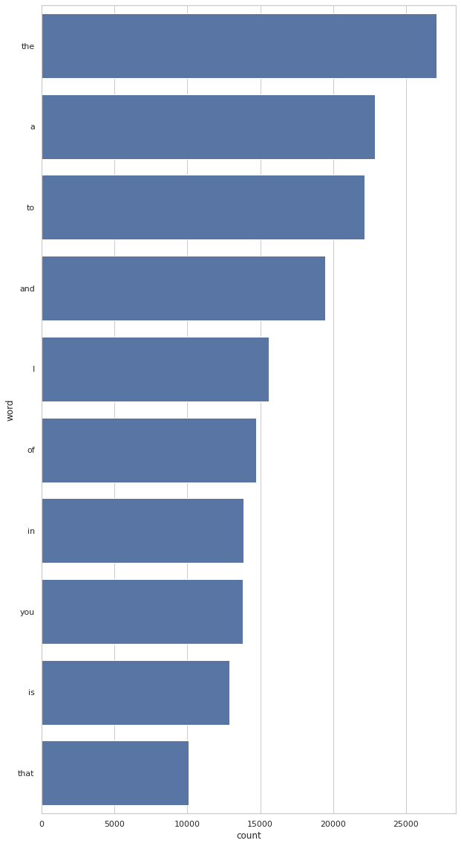
Data Visualization
Most commonly
used before cleaning
29/07/2022
INT 200

Slide 14
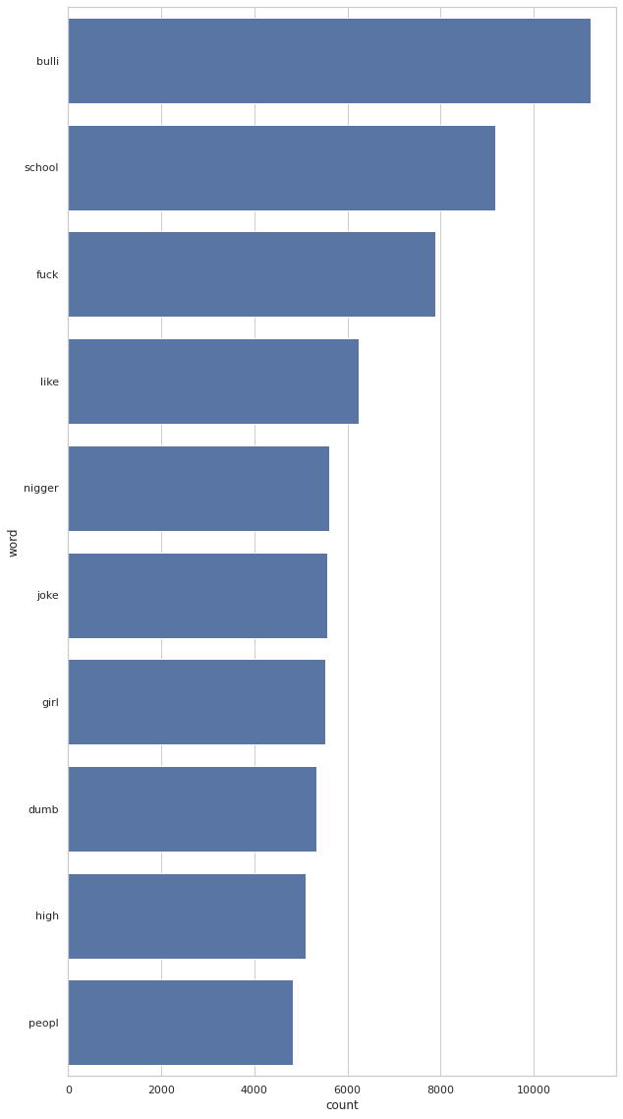
Data Visualization
Most commonly
used after cleaning
29/07/2022
INT 200

Slide 15
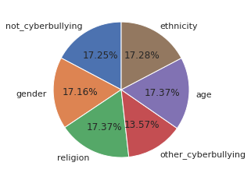
Data Visualization
Pie Chart
29/07/2022
INT 200

Slide 16

Scope
An API is easy to
integrate with many
platforms and applications
29/07/2022
INT 200

Slide 17
The Problem Statement
To find the probabilities
of hate speech ,
offensive and normal
content in input text
29/07/2022
INT 200

Slide 18
Objectives
Previous Objectives | Current Objectives | Outcome
Big Data Preparation using Apache spark and Scala | Mining data from wikipedia (0.5 GB) and ebooks (1 GB) using web crawlers | Processed dataset containing textual matter in english
Implementing simpler version of BERT from scratch and building a classifier to classify hate speech and offensive contents | No Change in Objective | An AI model to classify input text as appropriate or potentially harmful
Building a local webpage to simulate the working of the model in real-time situations like social media | Building an API and integrating it with discord as an example to moderate a server | Moderating a discord server with the help of the trained model to detect hateful speech
29/07/2022
INT 200

Slide 19
Workflow Methodologies
29/07/2022
INT 200

Slide 20
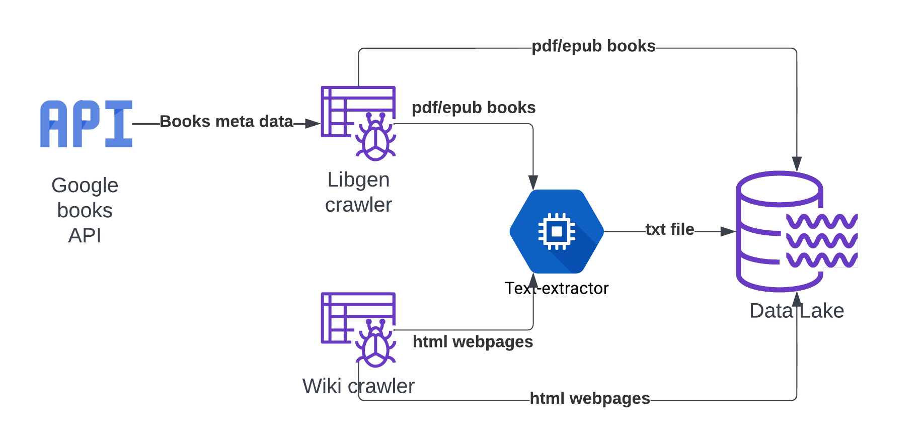
Overall workflow of Objective 1
29/07/2022
INT 200

Slide 21
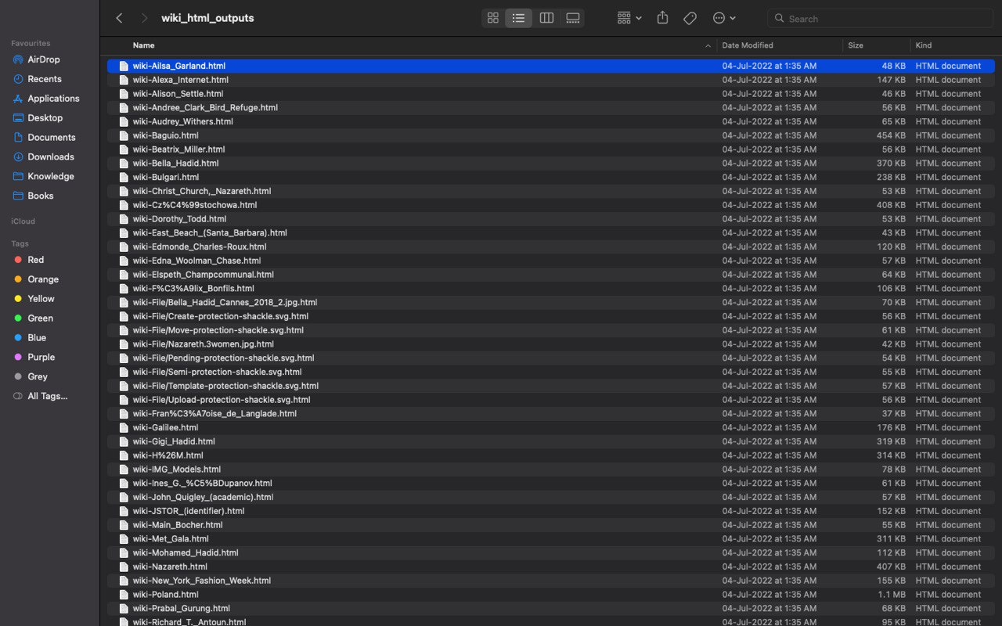
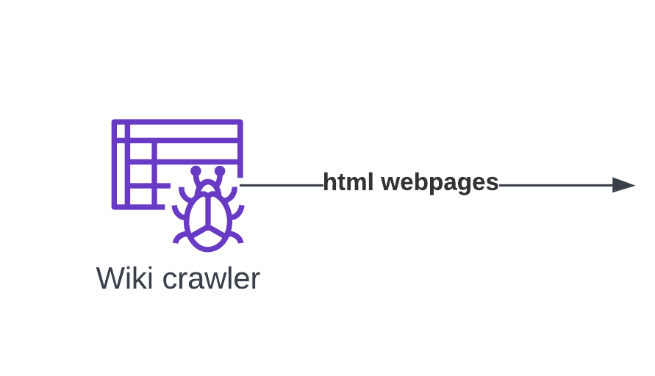
Mining data
(from wiki)
29/07/2022
INT 200

Slide 22
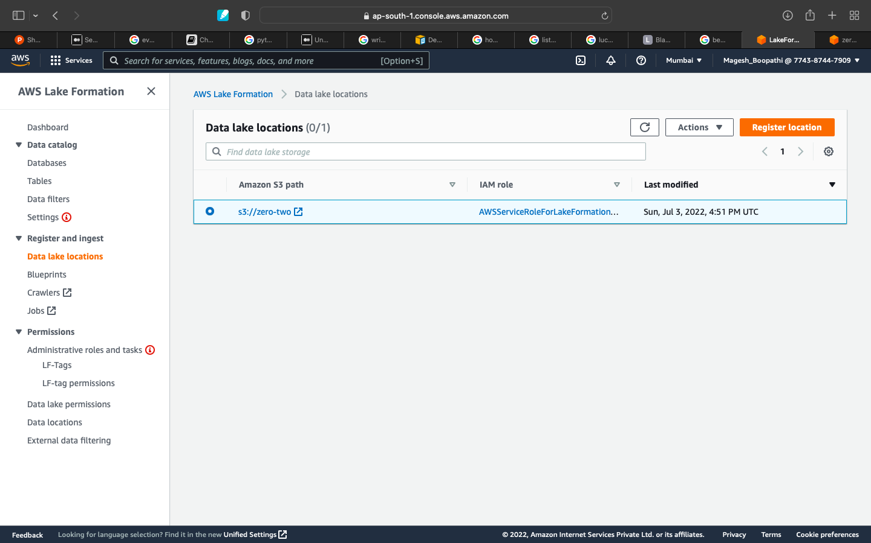

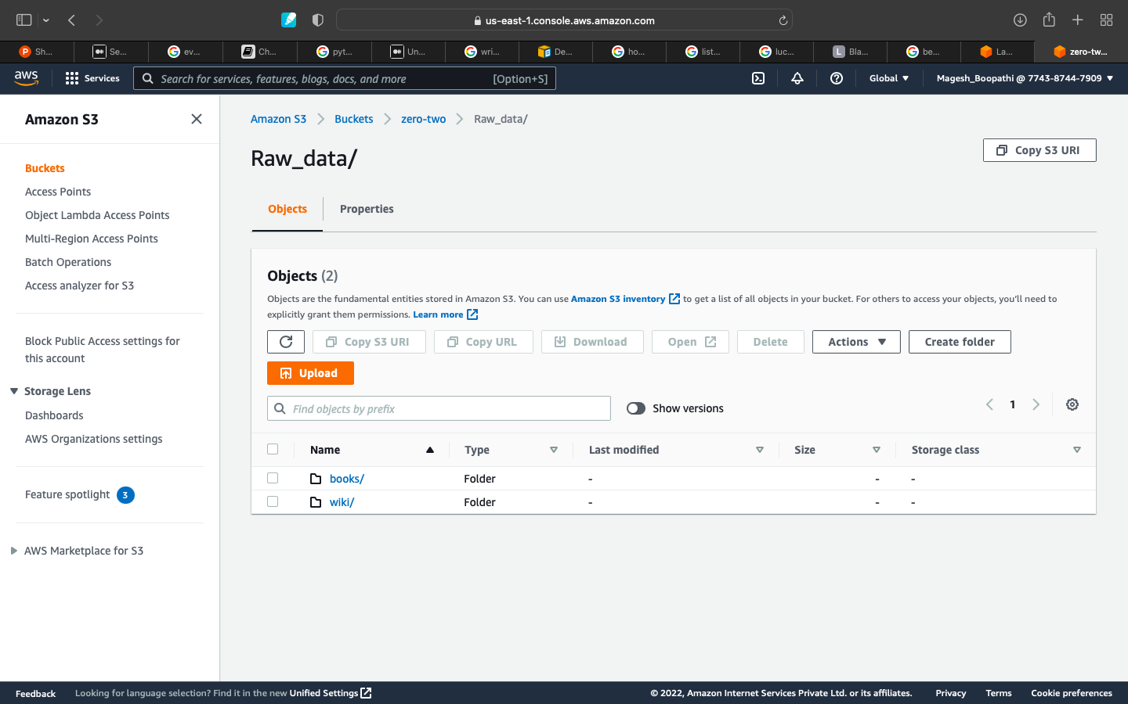
Mining data (storage)
29/07/2022
INT 200

Slide 23
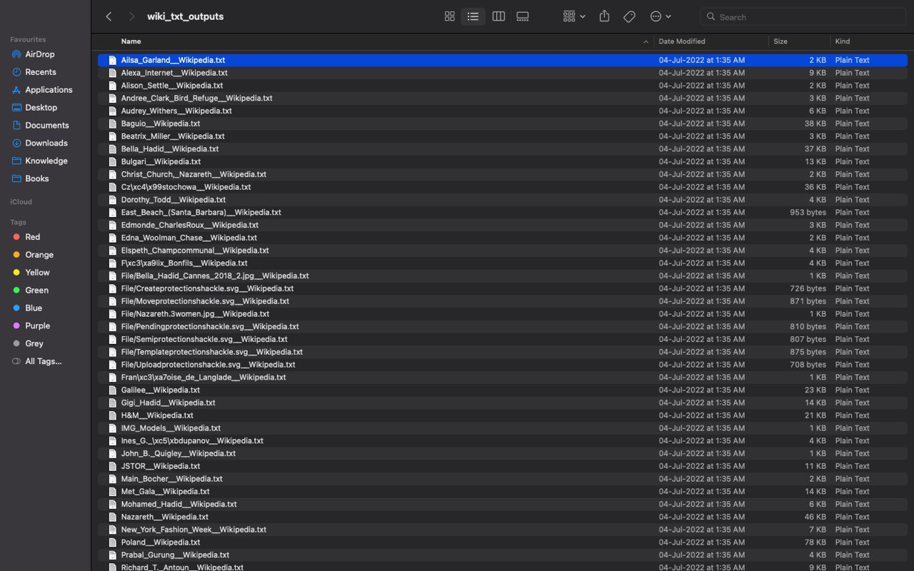
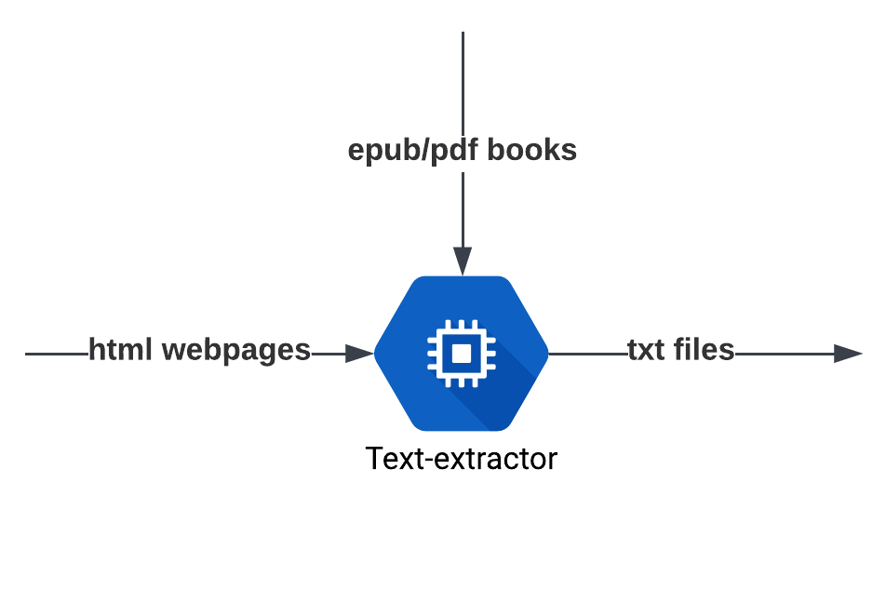
Mining data
(text - extraction)
29/07/2022
INT 200

Slide 24
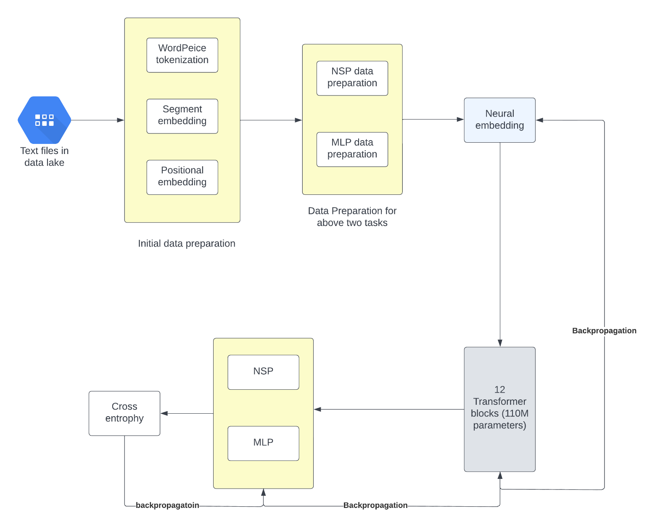
Overall workflow of Objective 2
29/07/2022
INT 200

Slide 25
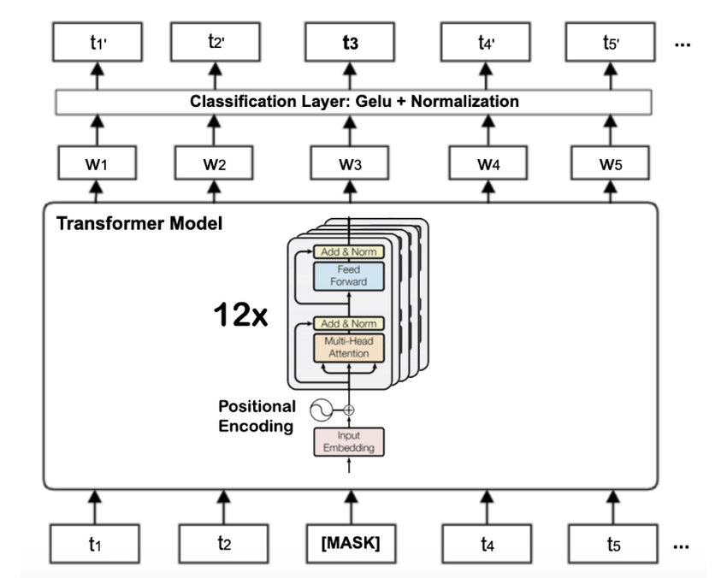
BERT Architecture
29/07/2022
INT 200

Slide 26
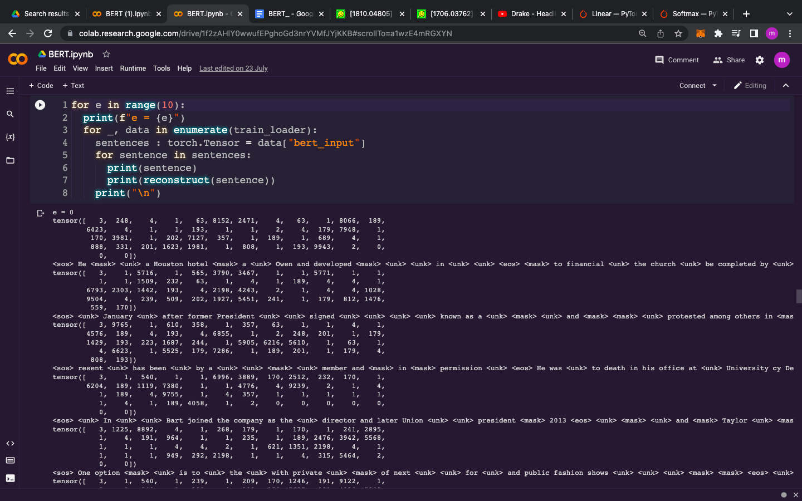
Text Embedding Output
29/07/2022
INT 200

Slide 27
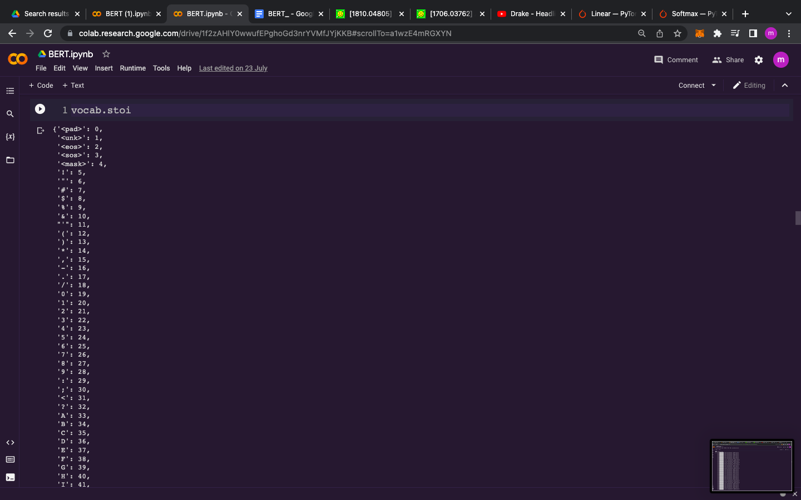
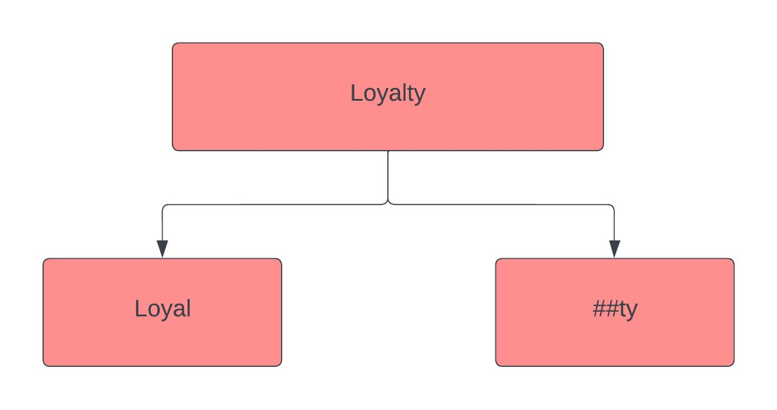
Token vocabulary
29/07/2022
INT 200

Slide 28
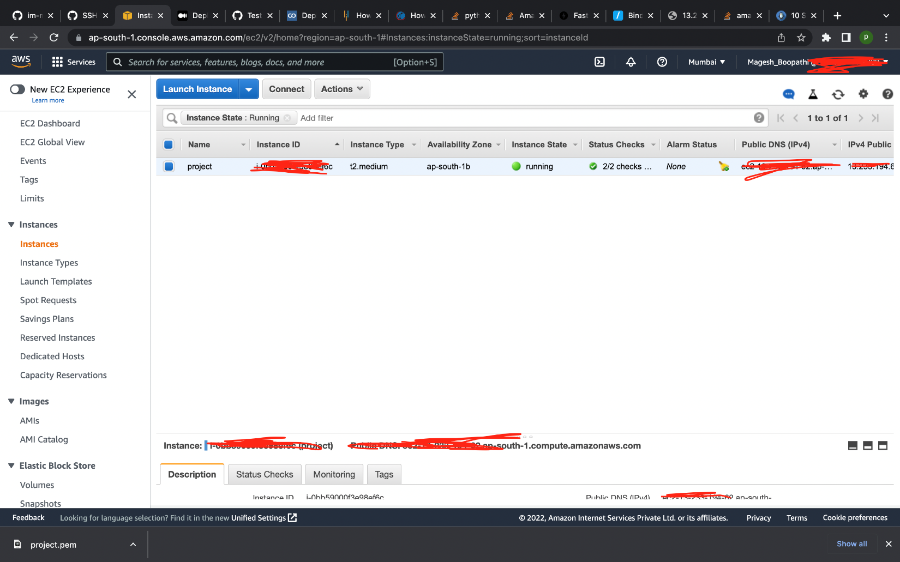
Objective 3
Deployment of Model with API
29/07/2022
INT 200

Slide 29
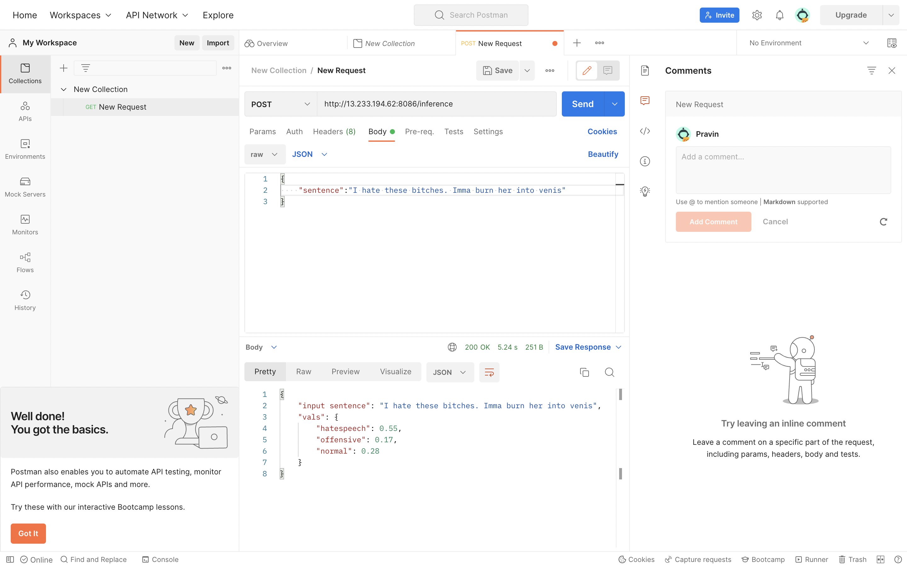
29/07/2022
INT 200

Slide 30
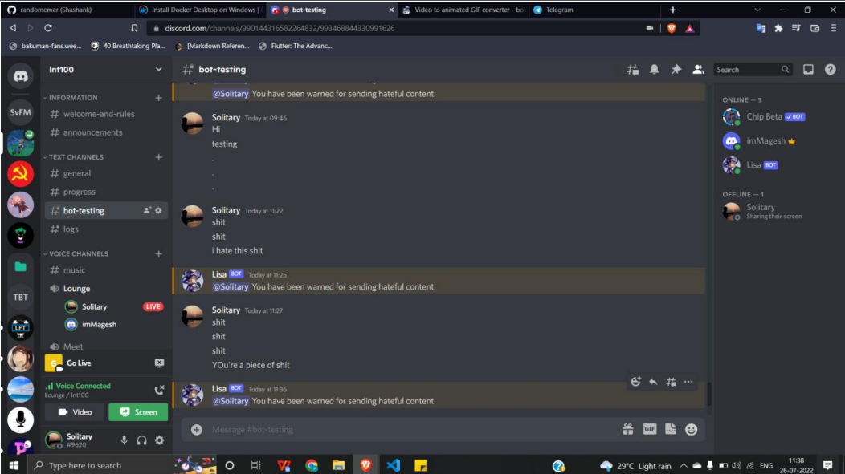
29/07/2022
INT 200

Slide 31
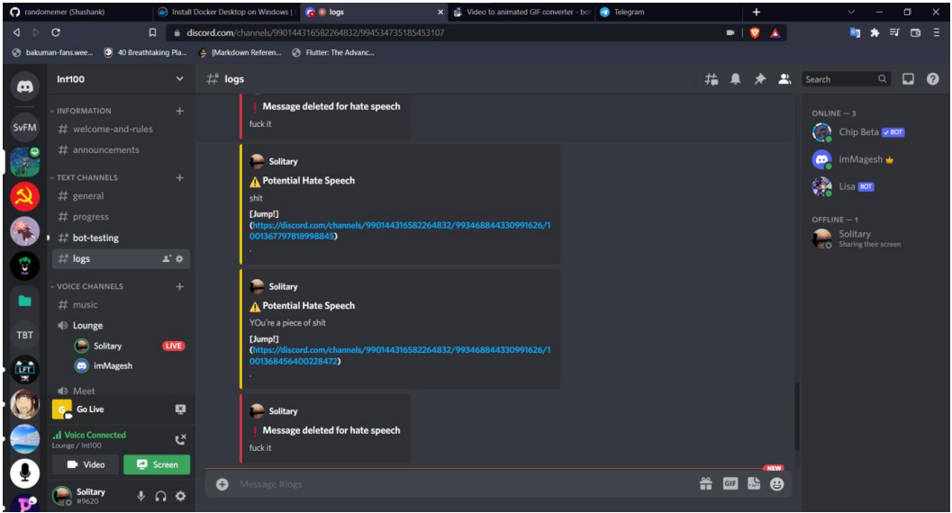
Integration with the API in Discord
29/07/2022
INT 200

Slide 32


Time Line
29/07/2022
INT 200

Slide 33
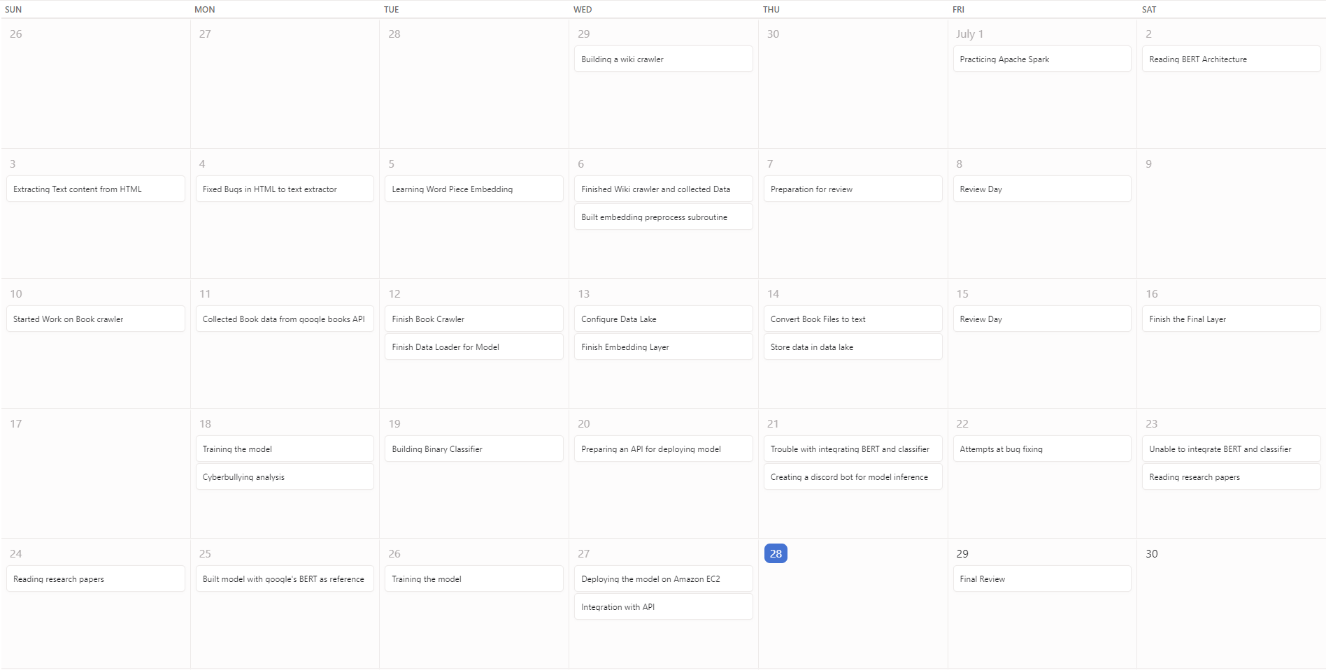
29/07/2022
INT 200

Slide 34
Source Citation
https://www.broadbandsearch.net/blog/cyber-bullying-statistics/amp
https://www.kaggle.com/andrewmvd/cyberbullying-classification
https://www.oxfordlearnersdictionaries.com/definition/english/cyberbully
29/07/2022
INT 200

Slide 35
Thank you

